Slide 1
Applied Natural Language Processing
Dr. Sucharitha Shetty

Slide 2
Table of Contents
Recall
RNN –Recurrent Neural Network

Slide 3

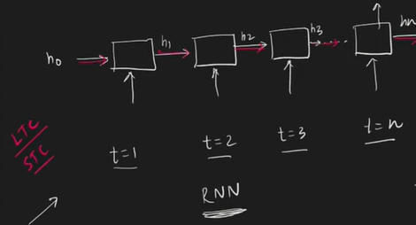
Notes:
Did you like the story

Slide 4
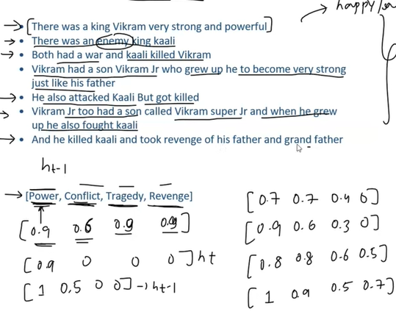

Slide 5
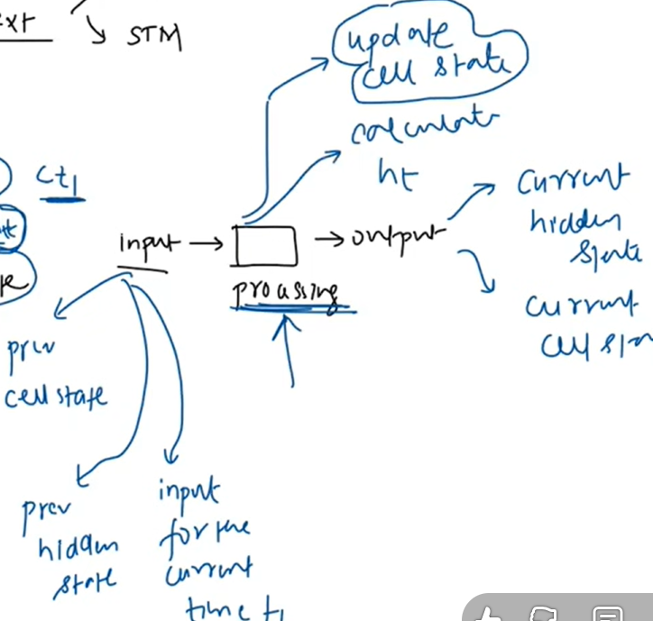
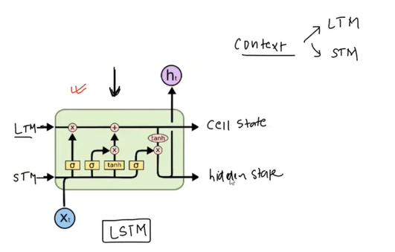
Table of Contents
Recall
RNN –Recurrent Neural Network

Slide 6
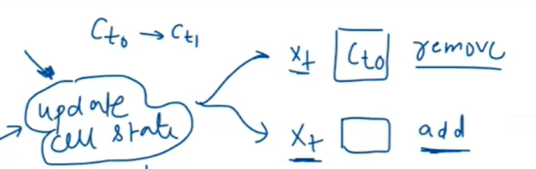
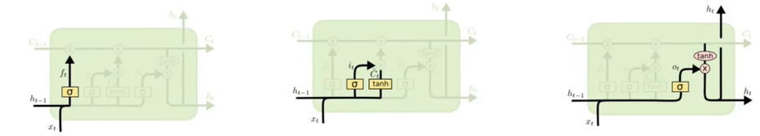

Slide 7
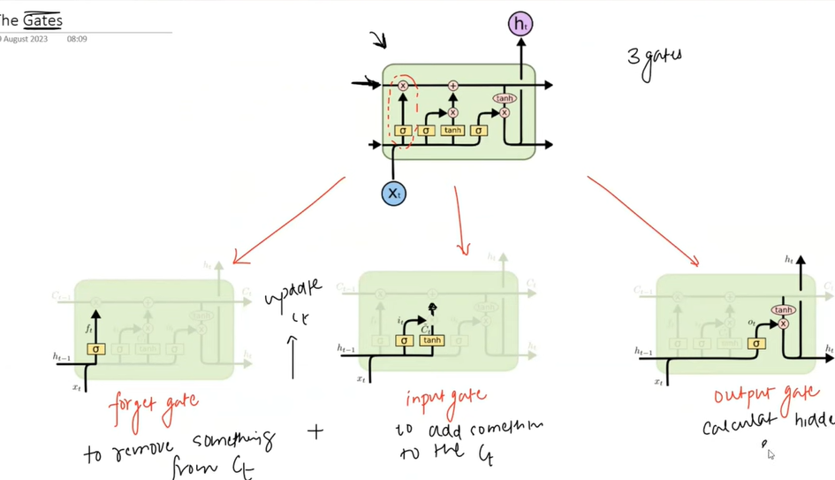

Slide 8
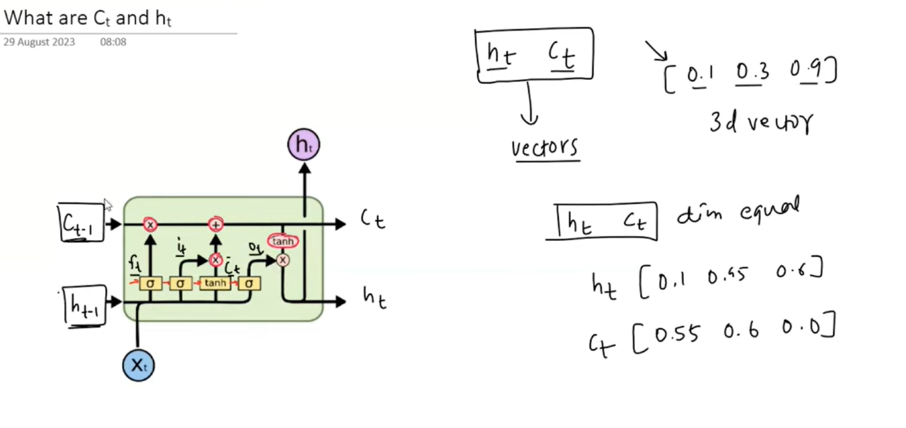

Slide 9
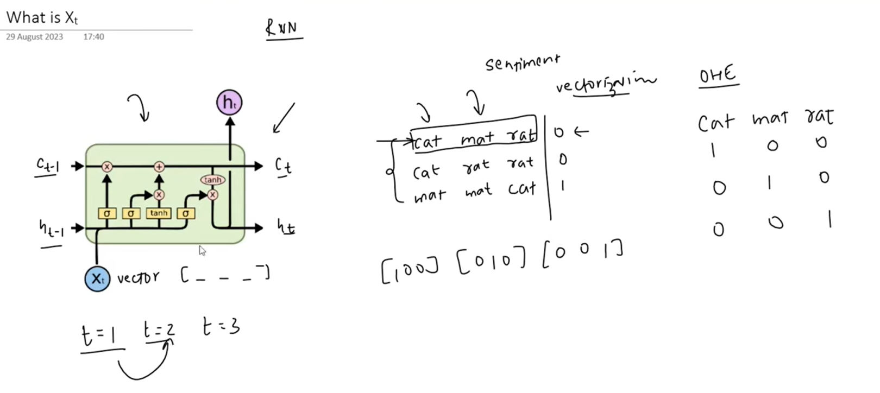

Slide 10
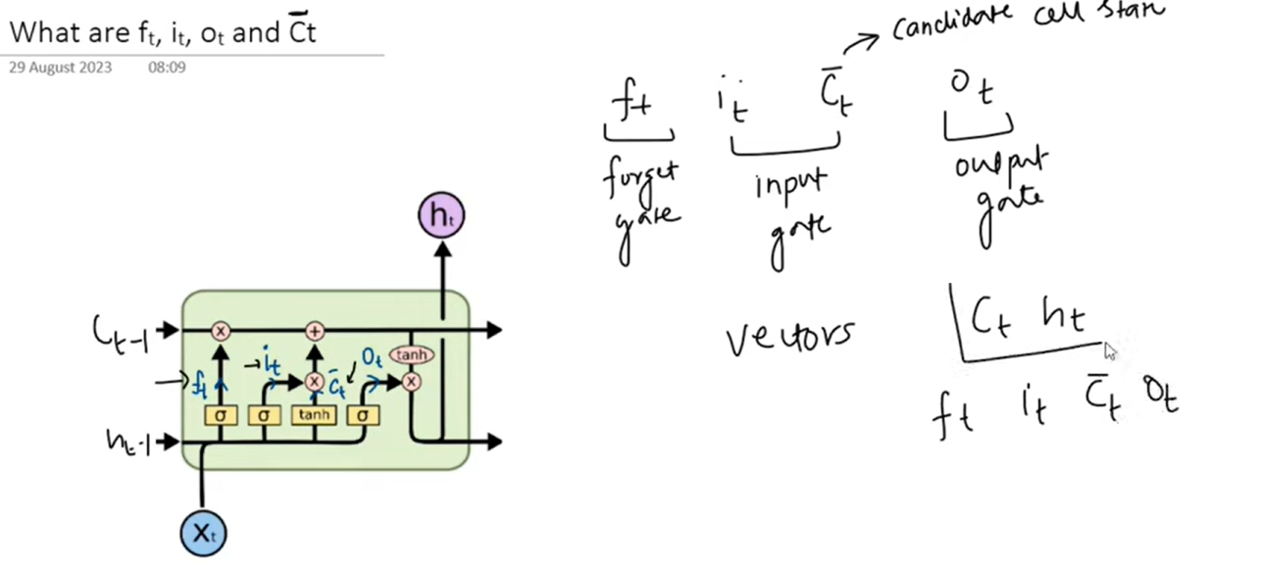
Notes:
Same dimension

Slide 11
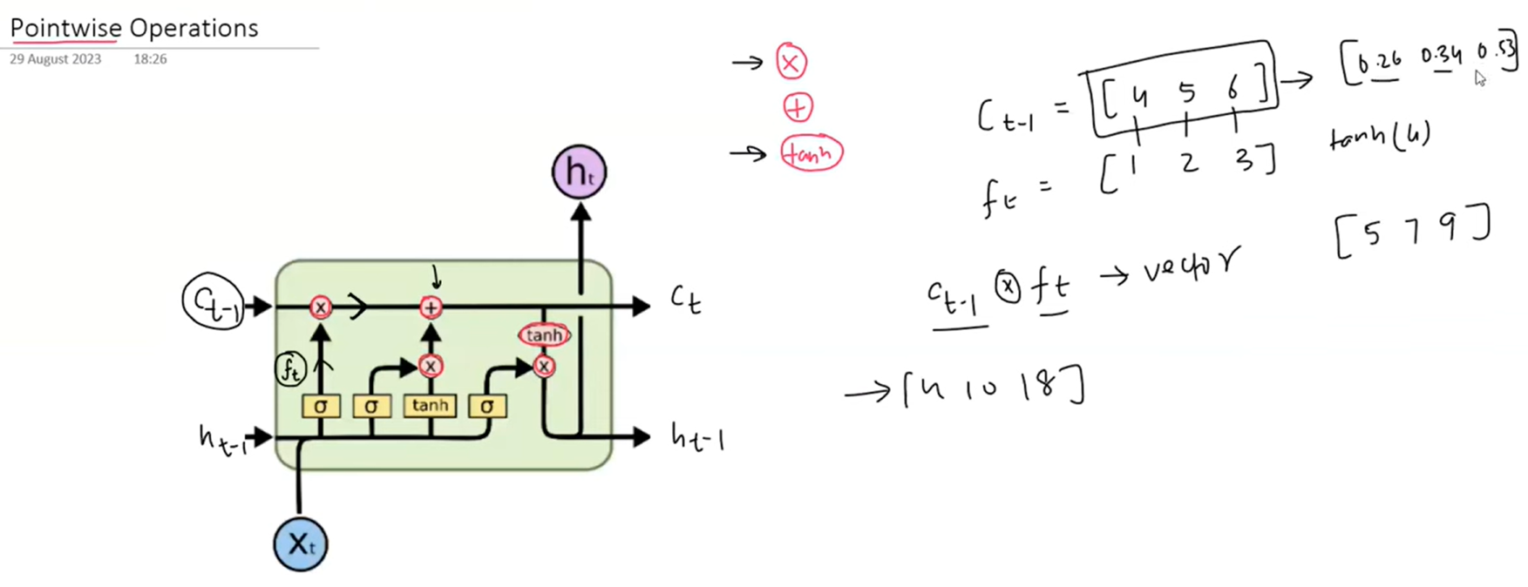

Slide 12
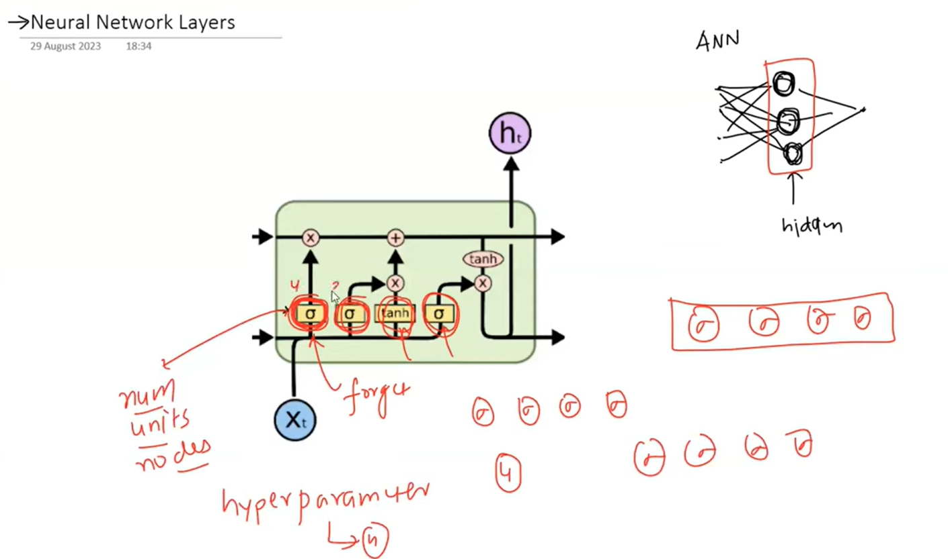

Slide 13
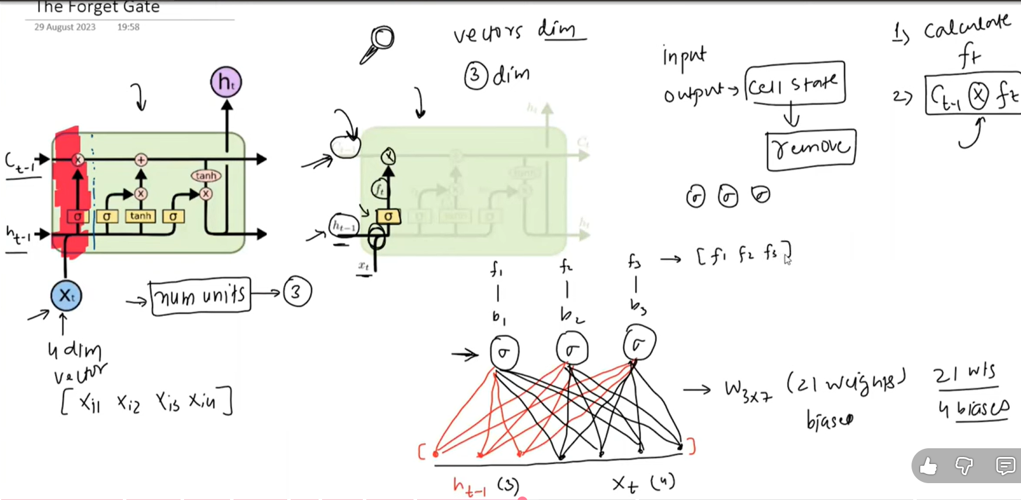

Slide 14
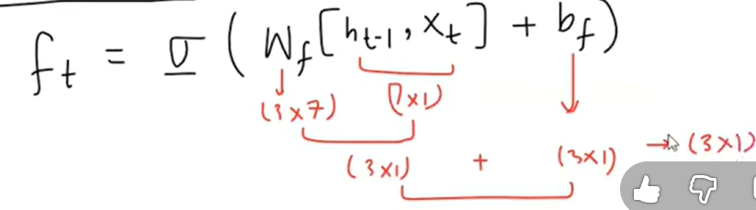
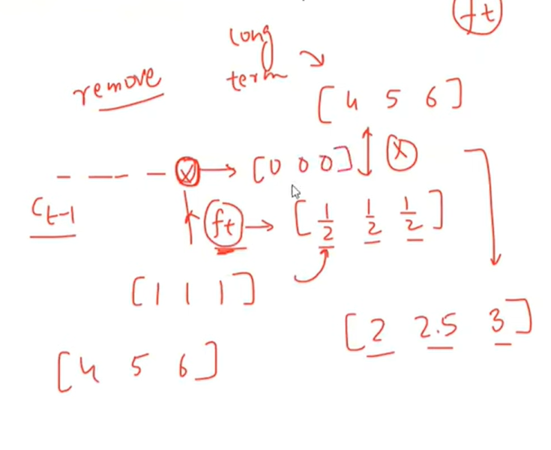
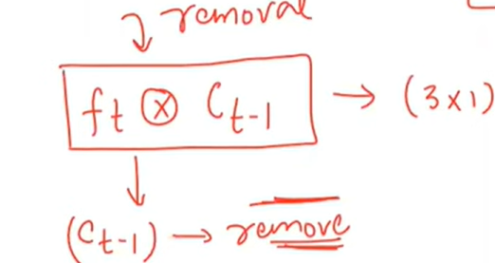

Slide 15
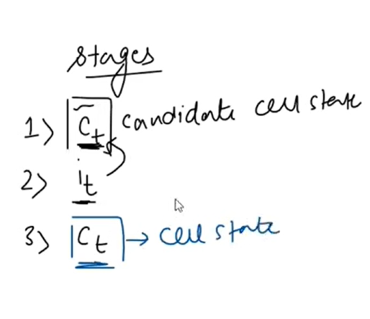

Slide 16
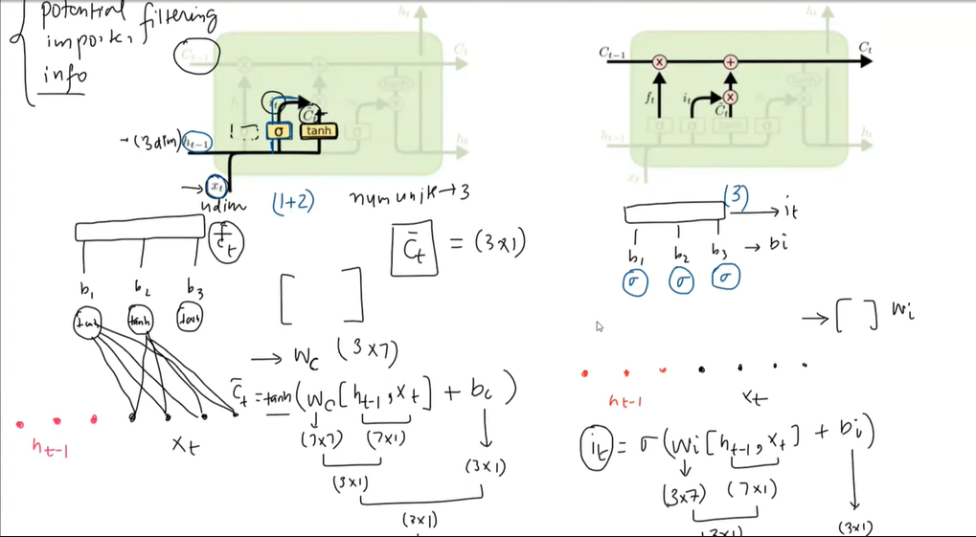

Slide 17
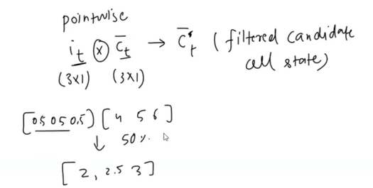

Slide 18
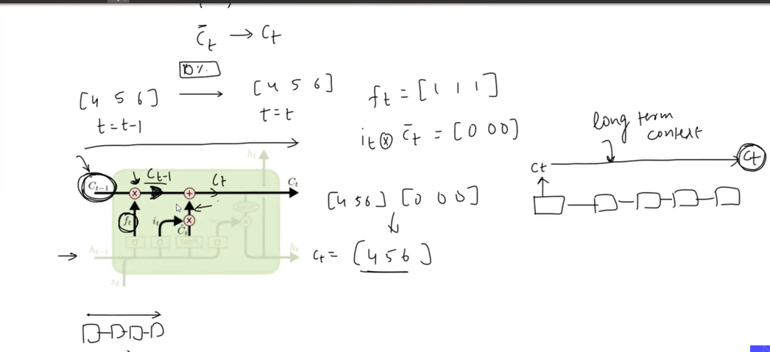

Slide 19
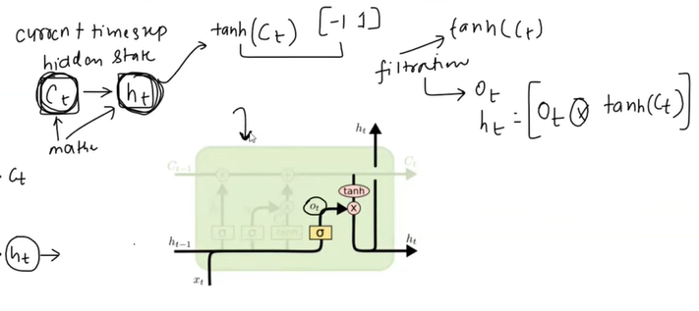

Slide 20
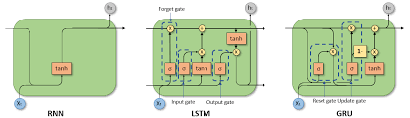

Slide 21
LSTM
Large parameters so LSTM becomes slow for training large dataset
LSTM(97) –GRU(2014)
GRU is lil simpler then LSTM

Slide 22
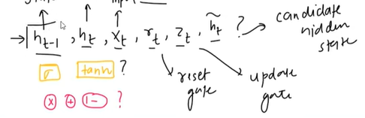
LSTM
VECTORS

Slide 23
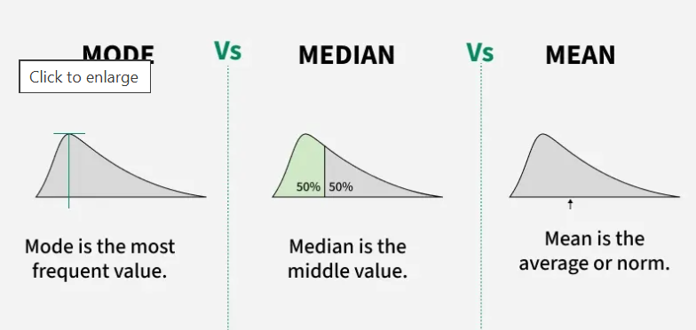
Mean, Median Mode

Slide 24
fit_transform vs transform
When to Use Each
fit_transform on Training Data: You use this for your training dataset to ensure the model learns the necessary transformation parameters (like the mean and standard deviation for scaling or vocabulary for text processing) only from the data it is allowed to see. It is generally more efficient than calling fit() and transform() separately on the same data.
transform on Test/Validation Data: You must use transform() on your test or validation data. This is crucial to prevent data leakage, where information from the test set (which is meant to be unseen data) influences the model's training or preprocessing steps. The test data is transformed using the exact same parameters that were calculated from the training data.

Slide 25
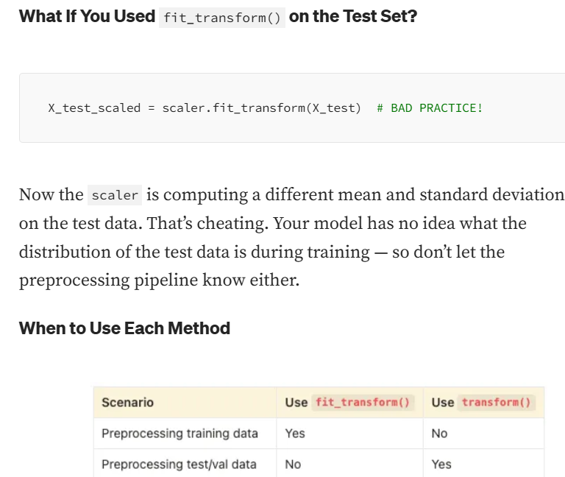

Slide 26
fit_transform vs transform
When to Use Each
fit_transform on Training Data: You use this for your training dataset to ensure the model learns the necessary transformation parameters (like the mean and standard deviation for scaling or vocabulary for text processing) only from the data it is allowed to see. It is generally more efficient than calling fit() and transform() separately on the same data.
transform on Test/Validation Data: You must use transform() on your test or validation data. This is crucial to prevent data leakage, where information from the test set (which is meant to be unseen data) influences the model's training or preprocessing steps. The test data is transformed using the exact same parameters that were calculated from the training data.

Slide 27
Normalization Vs standardization
Normalization scales data into a specific range (usually 0 to 1) using minimum and maximum values, making it ideal for algorithms not assuming distribution, like neural networks or K-Nearest Neighbors. Standardization centers data around a mean of 0 with a standard deviation of 1, handling outliers better and assuming a Gaussian distribution, which suits linear regression or logistic regression.
Notes:
https://medium.com/@abhishekjainindore24/normalization-and-standardization-of-data-408810a88307

Slide 28
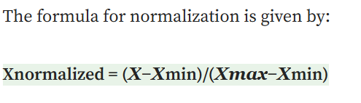

Key Differences Between Normalization and Standardization:
Normalization scales data into a specific range (usually 0 to 1) using minimum and maximum values, making it ideal for algorithms not assuming distribution, like neural networks or K-Nearest Neighbors. Standardization centers data around a mean of 0 with a standard deviation of 1, handling outliers better and assuming a Gaussian distribution, which suits linear regression or logistic regression.
Outliers:
Normalization: Highly sensitive to outliers because it relies on the minimum and maximum values.
Standardization: Less sensitive to outliers; it handles them better because it uses mean and standard deviation rather than absolute boundaries.
Notes:
https://medium.com/@abhishekjainindore24/normalization-and-standardization-of-data-408810a88307

Slide 29
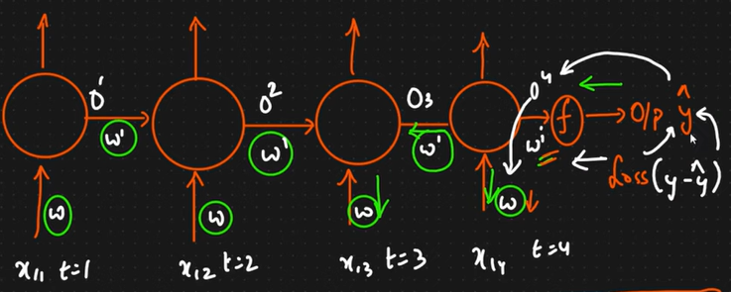
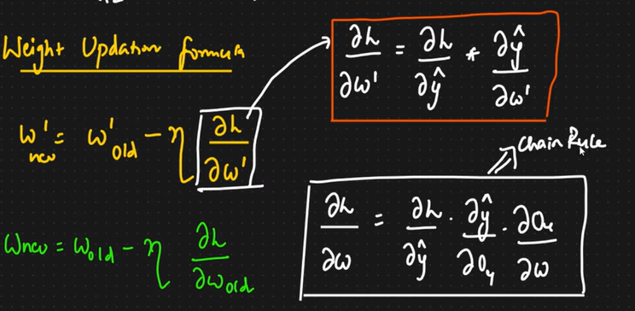
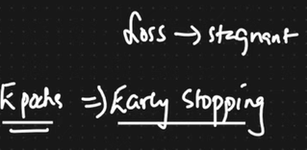
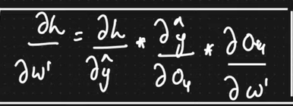
Backpropogation of RNN
Notes:
https://medium.com/@abhishekjainindore24/normalization-and-standardization-of-data-408810a88307

Slide 30
Key Differences Between Normalization and Standardization:
If 100 timestamps
Notes:
https://medium.com/@abhishekjainindore24/normalization-and-standardization-of-data-408810a88307

Slide 31
Thank You

